Slide 2
Health Equity Matters Poverty and Income
July 2019
Saralyn Semeniuk
Health Promoter
Notes:
This presentation on Poverty and Income is the third of 7 modules developed to increase staff knowledge about the topics highlighted in the Health Equity Matters campaign.

Slide 3
Outline
Social determinants of health (SDOH)
Health equity and the SDOH
Poverty myths and facts
Poverty, income and health
Policies, programs, and partnerships to make a difference
Notes:
During this presentation, we’ll do a brief review of the Social Determinants of Health and Health Equity.
And we’ll look at the effects that poverty and income can have on health.
Some myths and facts about poverty will be presented, and we’ll also review some of the actions currently being taken to improve income, and reduce the negative impacts of poverty.

Slide 4
What Factors Influence our Health?
Notes:
Health is influenced by many factors, called the determinants of health. These include personal characteristics such as sex and genetics, as well as the economic, social and physical environments where we live, learn, work and play.
They are called determinants of health because they can determine the health issues that a person may face and/or the resources and choices available to them as they try to be and stay healthy.
As shown in this diagram, the social, economic and physical environments account for about 60% of health outcomes, while health care accounts for about 25%.
Canadian Institute for Advanced Research
http://www.hclinkontario.ca/images/2017/2017-03-28_BasicIncomeSlides.pdf

Slide 5
Social determinants of health (short list)
Income and social status
Social support networks
Education and literacy
Employment/working conditions
Healthy child development
Food insecurity
Housing
Access to heath care
Gender
Culture
Language
Disability
Notes:
The social determinants of health are the social and economic factors that influence the health of a population.
This list shows some of the common factors referred to as social determinants of health, but there are many more.
And these factors overlap and cluster into groups of disadvantage and marginalization for individuals and populations.

Slide 6
SDOH and Health
↓ access to SDOH
=
↑ risk of poor health
Notes:
These social determinants of health are not equally distributed in our society. Differences in access to the social determinants of health means that some people or groups have greater risk of poor health.

Slide 7
Health Equity and SDOH
Health inequities
differences in health experienced by people that are systemic and socially produced
Priority populations
groups at risk of negative health outcomes due to health inequities
e.g. low income or homeless individuals
Notes:
Health inequities are differences in health experienced by people that are systemic or socially produced, and therefore can be changed.
These differences are considered unfair or unjust.
Priority populations are those groups at increased risk of negative health outcomes because of health inequities.

Slide 8
Health Equity and SDOH
Health equity exists when everyone has a fair chance to achieve their best health
This means that everyone has equal access or opportunity to the SDOH
Notes:
Health equity means that all people can reach their full health potential and are not disadvantaged from attaining it because of their race, ethnicity, religion, gender, age, social class, socioeconomic status or other socially determined circumstance.

Slide 9
Notes:
We can help to ‘level the playing field’ by approaching things with a health equity lens and giving people what they need to achieve optimal health.
Which isn’t necessarily the same as equality – or giving all people the same thing.

Slide 10
Poverty Myth and Fact #1
Myth:
Poverty is about bad personal choices.
Fact:
Poverty is a complex and multifaceted reality, rooted in systemic barriers, injustice, inequity, and social exclusion.
Notes:
People living in poverty often experience discrimination based on gender, racialization, disability, and other forms of exclusion that keep them from fully participating in society.
People who experience multiple barriers are particularly vulnerable to deep poverty.
In addition, weak social policies lead to rights violations, including a lack of access to safe, affordable housing, healthcare, education, secure employment, healthy food, adequate childcare, and income supports.
People in circumstances like these did not arrive there as a result of their own choice.

Slide 11
Poverty Myth and Fact #2
Myth:
Poverty is not a real problem in Canada.
Fact:
In 2017, the Poverty Rate in Canada was 9.5%
(Market Basket Measure, 2017)
Notes:
Although the poverty rate in Canada has declined in recent years, nearly 1 in 10 people still live in poverty.
And child poverty in Canada is also still persistent at 9%, almost 30 years after the unanimously supported 1989 Parliamentary motion to end child poverty in Canada by the year 2000.

Slide 12
Poverty and Health
World Health Organization has declared poverty the single largest determinant of health
Income inequality is associated with the premature death of 110 Canadians each day (40,000/year)
(Stats Canada, 2013)
Notes:
The World Health Organization has declared poverty the single largest determinant of health.
The biggest predictor of one's health is one's wealth.
It's not just the poor who are suffering; every step down the income pyramid corresponds to worse health.
Study after study has shown that those at the top of the income pyramid live on average longer and healthier lives than all those below.

Slide 13
Poverty and Health
Child poverty →
Higher mortality
More likely to have low birth weight, asthma, type 2 diabetes, poorer oral health, malnutrition
More behavioral and emotional challenges, developmental problems, worse school performance
More likely to live in poverty in adulthood
Notes:
Children from less affluent families are more likely to experience conditions that limit their health and ultimately their life chances such as:
inadequate or delayed health care, physical inactivity, poor nutrition, insecure or substandard housing, injuries, and exposure to toxins, high lead levels and violence.
The influence of wealth on health begins even before a child is born, shaping the quality of prenatal care an expectant woman receives, her level of stress during pregnancy and her likelihood of delivering a premature or low birth weight baby.

Slide 14
In Northern Ontario…
Among the 30 Ridings in Canada with the Highest Child Poverty Rates:
Kenora has the 7th highest rate
Number of low income children, age 0-17: 6090
Rate of low income children, age 0-17: 34.7%
Source: Campaign 2000 Child Poverty by Riding Report, June 2018
Notes:
In a 2018 Campaign 2000 report, Kenora was ranked with the 7th highest child poverty rate among the 30 ridings in Canada with the highest rates.

Slide 15
Income and Health
Lower income →
Higher mortality
Higher rates of disease
Poorer mental and physical health
Higher stress; lower perceived health
Less access to healthy food, affordable safe housing, health services, basic needs
Notes:
Those with lower income levels consistently have lower life expectancy, higher rates of disease like cancer, respiratory and cardiovascular disease, poorer mental and physical health, higher levels of stress and poorer perceived health.
There's a health gradient in society tied to income, jobs and work we do.
Our position in the pecking order, the nature and stability of our work conditions and employment situation, and our access to power, control and resources all have an impact on our health.
It's also affected by how much power and autonomy people have at work, their job security, job design, safety of work conditions, and the respect their occupational status commands.

Slide 16
In our region…
21% of people live in low-income households (14% for Ontario)
34% of children live in low-income households (17% for Ontario)
Unemployment rate of 8.1% (7.8% for Ontario)
(Source: 2016 Census; 2015 Canadian Taxfiler)
Notes:
In the Northwestern Health Unit catchment area:
21% of people live in low-income households
34% of children live in low-income households
And the Unemployment rate in our region is 8.1%

Slide 17
Poverty Myth and Fact #3
Myth:
The best solution to poverty is a job.
Fact:
Many people living in poverty are employed.
But the jobs are precarious – with inadequate wages and lacking in benefits and security.
Notes:
In fact, many people end up working multiple low-wage jobs that still do not cover essential costs.
Others have to choose between precarious work and inadequate social assistance if they cannot find affordable childcare, housing or transportation.
Others have challenges finding work that is accessible, which is a barrier to persons with disabilities.
In addition, systemic barriers and discrimination mean that some are excluded from employment or cannot work in their fields.

Slide 18
Employment in Ontario…
30% of workers in unstable employment
Part time work is 20% of total employment
Half of those making under $15/hour are
25-64yrs old (mostly women)
Full time work not always enough to ensure a life above the poverty line
Notes:
In Ontario, 30% of workers are in unstable employment.
Part time work makes up 20% of the total employment picture.
Half of those making under $15/hr are 25-64yrs old who are mostly women.
And we know that full time work in Ontario is not always enough to ensure a life above the poverty line.
Office of the Premier. (2017). Fair Workplaces, Better Jobs [News release]. Retrieved from https://news.ontario.ca/opo/en/2017/05/fair-workplaces-better-jobs.html

Slide 19
NWHU Catchment Area
Rapid Risk Factor Surveillance System: Social Determinants of Health Module Results
(December 2018):
Almost a third (29.9%) think that money is very or extremely important in influencing health
Over 1 in 6 people (17.1%) believe money is not very important or not at all important in influencing health
Notes:
In a survey done in 2018, respondents from our region were asked their opinion about the importance of the amount of money a person has with regard to its impact on their health.
Based on the results from the sample, almost a third of our population think that money is very or extremely important in influencing health.
However, over 1 in 6 people in our catchment area believe money is not very important or not at all important in influencing health.
These results indicate that there is some lack of awareness in our region about the influence that income and/or poverty have on health.

Slide 20
In Northwestern Ontario…
Higher proportion of the population with lower socioeconomic status than the rest of the province
→ more at risk for health inequities – in health outcomes, and access to care and basic needs
Many populations in the North face greater inequities than others
Notes:
In our region, there is a higher proportion of the population with lower socioeconomic status than the rest of the province.
This puts those who live in our catchment area at more risk for health inequities
Some 800,000 people living in Northern Ontario are more likely to have worse health, poorer access to health care and die earlier than people in other parts of Ontario.
In addition, many populations in the North face greater inequities than others.
(Northern Ontario Health Equity Strategy)

Slide 21
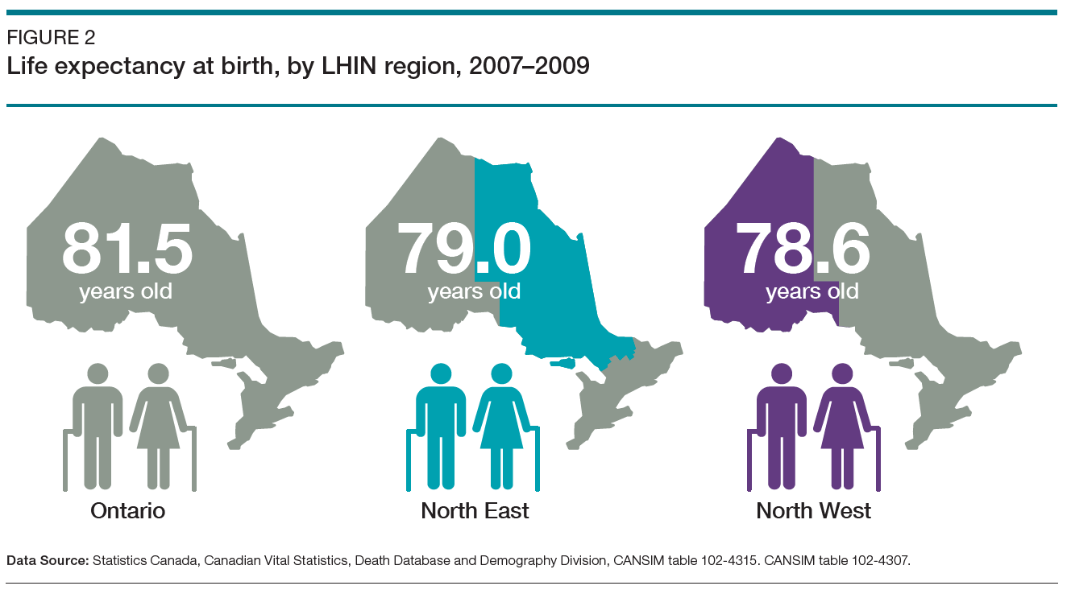
Life Expectancy in NW Ontario
Notes:
People in Northwestern Ontario have lower life expectancy at birth than those in Northeastern Ontario and Ontario.

Slide 22
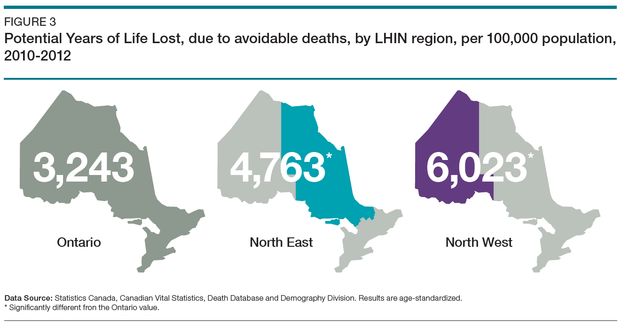
PYLL in NW Ontario
Notes:
In Northwestern Ontario, the Potential Years of Life Lost due to avoidable deaths is much greater – nearly double the provincial rate.

Slide 23
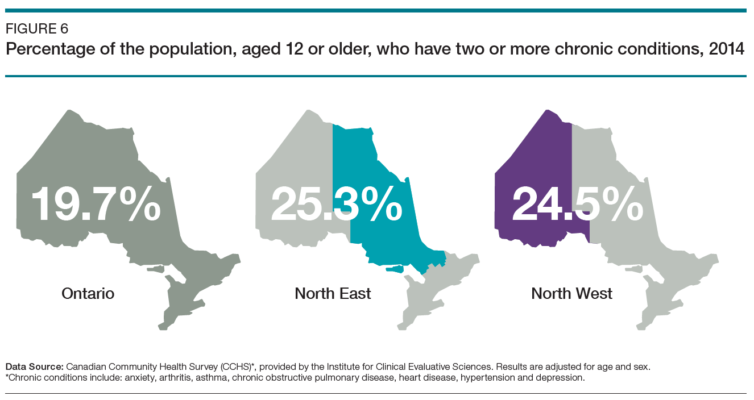
2 or more Chronic Conditions in NW Ontario
Notes:
And in Northwestern Ontario there’s also a greater incidence of chronic conditions compared to Ontario. These conditions include anxiety, arthritis, asthma, copd, heart disease, hypertension and depression.

Slide 24
Key Considerations
Income affects:
housing
food security
education
early childhood development & childcare
transportation
consistent access to health services and basic needs
Notes:
There are strong relationships between income, good quality employment and health.
Good work enables enough economic resources for material wellbeing and participating in community life.
It also contributes to psychosocial needs, including individual identity, social role and status.

Slide 25
Key Considerations
Lower income is associated with
precarious employment
low education
social exclusion
inadequate housing and nutrition
poorer physical and mental health
higher mortality rates
Notes:
Unemployment and poor-quality employment are strongly linked to poor physical and mental health outcomes and with an increased risk of mortality and suicide.
Unemployment also lowers living standards, increases psychosocial stressors and increases the likelihood of poorer heath behaviours, including excessive alcohol consumption, smoking and decreased physical activity.
http://www.instituteofhealthequity.org/resources-reports/voluntary-sector-action-on-the-social-determinants-of-health/voluntary-sector-action-on-the-sdoh-evidence-review.pdf

Slide 26
Poverty Myth and Fact #4
Myth:
People living in poverty already get enough support.
Fact:
A wide range of social programs is essential to support those living in poverty and the policies to effectively enable this are currently inadequate.
Notes:
These include income security, affordable and safe housing, access to healthcare, secure employment, food security, and affordable, high quality childcare.
There have been some improvements recently with the launch of the federal poverty reduction strategy and the national housing strategy .
However, more coordination with all levels of government, including Indigenous governments and communities, is essential to ensure that programs are adequate and responsive to immediate needs.

Slide 27
Policies to address income inequality
Countries with higher life expectancy have policies that protect workers, support families, and provide a safety net for all.
These policies address income and wealth inequality in two possible ways…
Notes:
Research shows that countries with higher life expectancy have policies that protect workers, support families, and provide a safety net for all.
These policies address income and wealth inequality in two possible ways.

Slide 28
Policies to address income inequality
1. Reduce the overall income gap so everyone has sufficient resources to prosper and maintain control over their lives
i.e. – basic income guarantee, earned income tax credits, secure pensions, guaranteed paid vacation and sick leave, job training for those unemployed
Notes:
The first approach reduces the overall income gap so everyone has enough resources to prosper and maintain control over their lives.
Examples of this approach are the basic income guarantee, earned income tax credits, secure pensions, guaranteed paid vacation and sick leave, and job training for those who are unemployed.

Slide 29
Policies to address income inequality
2. Make certain resources available to everyone; not dependent on a family's individual assets
i.e. – universal pre-school and childcare, health/dental/vision care, new parent support, land use and zoning policies (for affordable housing, recreation, etc.)
Notes:
The second approach makes certain resources available to everyone, which are not dependent on a family's individual assets.
For example, universal pre-school and childcare, health, dental and vision care, new parent support and land use and zoning policies - for things like affordable housing and recreation.

Slide 30
Policies to address income inequality
Elections provide an opportunity to vote for parties and candidates whose platforms support these policies.
Notes:
All eligible voters in Canada have the opportunity through our election processes to vote for parties and candidates whose platforms support these types of policies.
In recent years, the Northwestern Health Unit has made an intentional effort to encourage voters to become more informed about the impact political party policies will potentially have on the determinants of health such as income, employment, and housing.

Slide 31
Income and Health Equity Policy
Some current interventions & recommendations:
Bill 148, Bill 47
Ontario Basic Income Pilot
Income security reform
Canada’s first poverty reduction strategy: Opportunity for All
Notes:
We’ll now briefly review some of these current interventions & recommendations related to income and poverty.

Slide 32
Income and Health Equity Policy
Bill 148 – Fair Workplaces, Better Jobs Act
(August 2018)
minimum wage increase, better pay equity and benefits to help improve health/wellbeing
Bill 47 Making Ontario Open for Business Act
(November 2018)
Freezes the minimum wage at $14 per hour until October 2020
Notes:
In August 2018, Bill 148 – the Fair Workplaces, Better Jobs Act brought about a plan for minimum wage increases, better pay equity, and benefits to help improve health and wellbeing.
However, in November 2018, Bill 47 – the Making Ontario Open for Business Act, froze the minimum wage at $14 per hour until October 2020, whereby it will be adjusted to inflation.

Slide 33
Income and Health Equity Policy
Bill 47 - Making Ontario Open for Business Act
Additional proposed changes:
Eliminate equal pay for equal work for part-time, temporary and casual workers,
Eliminate scheduling protections,
Reduce paid and unpaid personal and family emergency days off, and
Reduce enforcement provisions.
Notes:
Bill 47 also proposed to:
Eliminate equal pay for equal work for part-time, temporary and casual workers
Eliminate scheduling protections
Reduce paid and unpaid personal and family emergency days off, and
Reduce enforcement provisions.

Slide 34
Income and Health Equity Policy
Basic income guarantee
a cash transfer ensuring the income needed to meet basic needs and to live with dignity, regardless of employment status
potential to alleviate or eliminate poverty, and reduce the long-term health and social consequences of poverty
Ontario Basic Income Pilot began in 5 communities in June 2017, then ended prior to completion by the Progressive Conservative government in March 2019
Notes:
The Basic income guarantee is based on the idea of universal income security—that everyone receives a modest, but adequate amount of annual income.
It’s been shown that an increase of $1,000 annually for the poorest 20% of Canadians would lead to 10,000 fewer chronic conditions and 6,600 fewer disability days every two weeks.
Unfortunately, the Ontario Basic Income Pilot which began in 5 communities in June 2017, was ended prior to completion by the Progressive Conservative government in March 2019.
Ontario Basic Income Pilot - https://www.ontario.ca/page/ontario-basic-income-pilot

Slide 35
Income and Health Equity Policy
Notes:
The Income Security – Roadmap for Change report, released in October 2017, recommended a fundamentally different approach in Ontario for supports and services that focus on people and their needs and rights.
It emphasized that social and economic inclusion, not just getting a job, should be the goal.
The report also recognized the realities of life on a low income in Ontario, and the impact that poverty has on different groups in Ontario society – particularly Indigenous peoples.
https://files.ontario.ca/income_security_-_a_roadmap_for_change-english-accessible_updated.pdf

Slide 36
Income and Health Equity Policy
November 2018 - Ontario's Minister of Community and Social Services outlined some reform goals for Ontario's social assistance system:
Move People to Employment
Locally Focused Social Services
Support People with Disabilities with Dignity
Cut Red Tape and Restore Accountability
Notes:
In November 2018, the Ontario Progressive Conservative government announced some new reform goals for the province’s Social Assistance system. Concerns have been raised that the reforms seem to emphasize employment without consideration for other individual social or economic circumstances.

Slide 37
Poverty Myth and Fact #5
Myth:
Poverty is too complicated to eradicate
Fact:
Poverty is complicated, but a comprehensive strategy that involves all levels of government, including Indigenous governments and communities can lead to its eradication.
Notes:
The current federal poverty reduction strategy is now regulated, but it requires additional programs, funding, and data analysis to be effective.
As for the cost, poverty already costs Canada billions of dollars, due to increased healthcare needs, social breakdown costs, as well as the costs of a fragmented and inadequate policy responses.
A comprehensive, adequately funded strategy can have social and economic benefits.

Slide 38
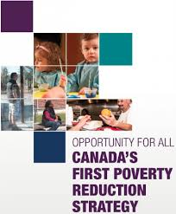
Income and Health Equity Policy
Notes:
In August of 2018, Canada launched it’s first poverty reduction strategy. Accountability measures are included, such as Canada's first official poverty line, and the creation of a National Advisory Board on Poverty that will regularly track and report on progress.

Slide 39
Income and Health Equity Policy
Canada’s First Poverty Reduction Strategy: Opportunity For All
Aims to:
reduce poverty by 50% by 2030
reduce chronic homelessness by 50%
improve water quality on reserves by 2021; and
reduce housing needs for 530,000 households.
Notes:
The strategy aims to:
reduce poverty by 50% by 2030
reduce chronic homelessness by 50%
improve water quality on reserves by 2021; and
reduce housing needs for 530,000 households.

Slide 40
Poverty Myth and Fact #6
Myth:
A charity response is sufficient to address poverty.
Fact:
Charities are often not able to address the systemic roots of poverty, though many are engaged in advocacy to promote strong social policy.
Notes:
Charitable efforts to support people living in poverty like food banks and clothing depots are often very important to meeting immediate needs and also to creating a sense of community and belonging.
However, charities are often not able to address the systemic roots of poverty, though many are engaged in advocacy to promote strong social policy.
Food bank use has been rising in Canada since 2008, and many cannot continue to operate with increased demand. Food banks do not solve food insecurity, just as shelters do not solve homelessness.
A comprehensive approach is needed to address the complexity of poverty.

Slide 41
Role of Public Health
Support a system and government-wide approach to identify the factors that influence health (SDOH)
Engage partners in effective community interventions and mitigation strategies (i.e. - as part of our Health Equity Impact Assessment processes)
Encourage policies to support the reduction of systematic social, economic and environmental barriers to good health
Notes:
The public health sector can:
Support systems and governments in identifying the factors that influence health.
We can engage partners in effective community interventions and mitigation strategies – for example, as part of our Health Equity Impact Assessment processes.
And we can encourage policies to support the reduction of social, economic and environmental barriers to good health.

Slide 42
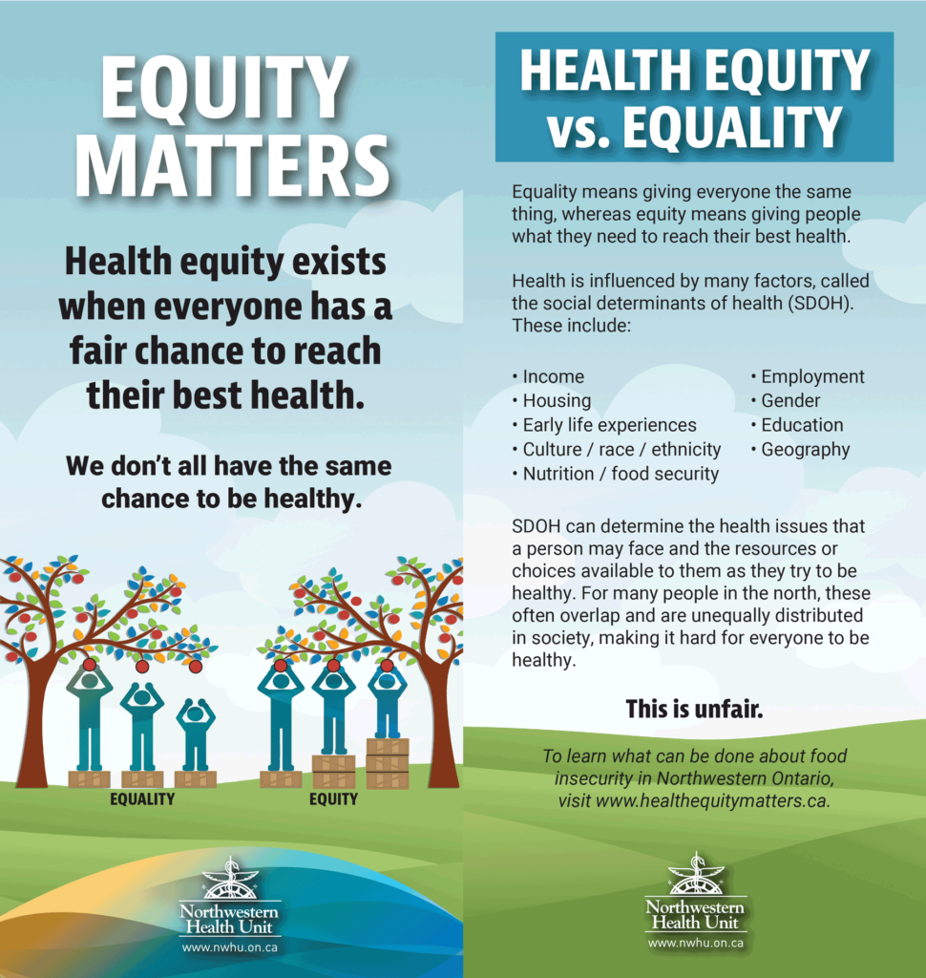
Notes:
We can also increase awareness of the importance of Health Equity among the public and our community partners, which is one of the objectives of our Health Equity Matters campaign.

Slide 43
Role of Public Health
Notes:
‘Income Matters’ is the third of 7 topics we will be highlighting through the campaign.
Knowing that 1 in 6 people in our region don’t think money has an important influence on health, it’s clearly important to increase awareness on this topic.

Slide 44
Role of Public Health
Notes:
Income Matters messaging will be shared with the public through posters, rack cards, social media, news website banners, radio ads and on the Health Equity Matters website.

Slide 45
Poverty Myth and Fact #7
Myth:
Poverty does not affect me.
Fact:
Everyone is affected by poverty. Millions of people in Canada struggle each day to get by, and this has broad health, social, cultural, and economic ramifications.
Notes:
And lastly, Poverty Myth and Fact #7…
Myth:
Poverty does not affect me.
Fact:
Everyone is affected by poverty. Millions of people in Canada struggle each day to get by, and this has broad health, social, cultural, and economic ramifications, both now and for future generations.
If our social policies address the needs of the most vulnerable populations, we all will benefit.
We are mandated by the Ontario Public Health Standards to address health inequities and their root causes. And we have an obligation to help ensure that our society includes everyone, so that no one is left to suffer on their own.
We all have a role to play in ending poverty.

Slide 47
