Slide 2
Food Insecurity
2018
Julie Slack, MSc, RD & Chelsea Socholotuk, RD
Notes:
This presentation has been adapted by the OSNPPH power point – OSNPPH Food Security Workgroup – Responses to Food Insecurity Sub-group
Position Statement on Responses to Food Insecurity
– issue, background, current status, key considerations and conclusions or next steps.

Slide 3
Overview
The Issue: Food Insecurity
Definitions: Food security, food insecurity, hunger
Background and Current status: Food security and Nutritious Food Basket data
Key Considerations: Food security vs. food literacy programs, solution
Next Steps: What can you do
Notes:
The first part of this presentation defines terminology and discusses the relevance of food insecurity to public health practice in Ontario and specifically looking at NWO.
Community responses to the persistent problem of food insecurity are examined and key messages of the Position Statement are discussed.

Slide 4
The Issue
Not all Canadians can afford to put enough food on the table and it’s not because food prices are too high….more often, it’s because the dollars at hand just can’t be stretched far enough.
Notes:
There is a misconception that the (increasing) cost of food is the reason why families/people can’t afford healthy foods. However, the food costs in Canada are not high enough to support the many local farms and growers we once had. The real issue is that minimum wage and social assistance rates are not keeping pace with the increasing food (and everything else like rent, hydro, gas, etc.) costs.

Slide 5
Household Food Security
Food security exists in a household when all people, at all times, have physical and economic access to sufficient, safe and nutritious food to meet their dietary needs and food preferences for an active and healthy life.
Household Food Insecurity [HFI]
Inadequate or insecure access to food because of financial constraints.
Notes:
one of the main take-away message from today is actually understanding the difference between this 2 concepts. Food insecurity is inadequate or insecure access to food because of financial constraints.
((Reference: Tarasuk V, Mitchell A, Dachner N. (2016). Household food insecurity in Canada, 2014. Toronto: Research to identify policy options to reduce food insecurity (PROOF). Retrieved from http://nutritionalsciences.lamp.utoronto.ca/] ))
Food insecurity is also known as ‘food poverty’.
People within food insecure households worry about having adequate amounts of food, they many not eat suitable quality or selections of foods, and/or they have inadequate amounts of food.
HFS is comprehensively defined as (…). On the other hand, HFI is simply understood as (…).
Looking at the terms it seems that one should be the opposite of the other. But when we look closely at the definitions, there is one key element in there that makes this untrue– financial constraints, or in other words poverty, are the root cause for HFI.
So how exactly does poverty makes a difference in these concepts, why is so important to understand that and, mostly, why should we not conflate these 2 definitions? Let’s do a small activity to understand this better.

Slide 6
Hunger
An individual-level physiological condition that may result from severe food insecurity with a high level of food deprivation
Individuals who experience food insecurity may or may not experience hunger
Notes:
The term ‘hunger’ is often used instead of ‘food insecurity’ because its meaning is more commonly understood. However, hunger and food insecurity are conceptually different. Hunger is an individual-level physiological condition that may result from severe food insecurity with a high level of food deprivation. Food insecurity is a household-level economic and social condition of limited or uncertain access to food. People who experience food insecurity may or may not experience hunger.

Slide 7
Background and current Status

Slide 8
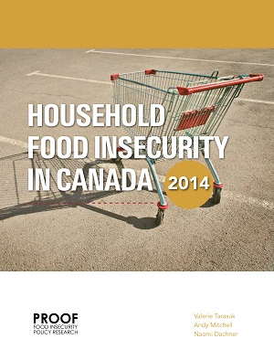
How is food insecurity measured?
Household Food Security Survey Module (HFSSM)
18 questions
Part of Canadian Community Health Survey
Reports produced by Food Insecurity Policy Research (PROOF)
http://proof.utoronto.ca/resources/proof-annual-reports/
http://proof.utoronto.ca/resources/fact-sheets/
Notes:
The Household Food Security Survey Module (HFSSM) has been administered on the Canadian Community Health Survey (CCHS) since 2004. The CCHS is a cross sectional survey that collects health related information from about 60,000 Canadians per year.
The HFSSM consists of 18 questions about the food security situation in the household over the previous 12 months. Based on the number of positive or “Yes” responses to the questions in the HFSSM, households are classified as either food secure or marginally, moderately or severely food insecure.
Comprehensive reports and resources (including a series of 4 new factsheets) on food insecurity in Canada are produced by PROOF an international interdisciplinary
research team for identifying policy interventions to address household food insecurity.

Slide 9
How many Ontarians are affected by food insecurity?
Reference: Tarasuk V, Mitchell A, Dachner N. 2016. Household food insecurity in Canada, 2014. Toronto: Research to identify policy options to reduce food insecurity (PROOF). Retrieved from: http://proof.utoronto.ca.
Notes:
This graph illustrates prevalence of total household food insecurity (marginal + moderate + severe) in Ontario for the period of 2005 through 2014. The prevalence has held steady at around 12% of Ontario households.
To put the prevalence of households experiencing food insecurity into perspective in terms of how many people we are talking about, in 2013, 12.5% of Ontario households experienced food insecurity. This translates into over 1.5 million people (1,598,200), of whom 30%, or over 485,000 (485,700) were under the age of 18.
In NWO there are approximately 1,607 people who are food insecure (CCHS 2011/12).

Slide 10
3,900 people living in NWO
are food insecure.
Notes:
In NWO there are approximately 3,900 people who are food insecure (CCHS 2013/14).
Who is at MOST risk?
Households with children <18 led by a female lone parent
Households relying on social assistance
Indigenous households
People who rent

Slide 11
Relationship between food insecurity and health
Health and well-being are closely linked to household food security
Food insecurity can be both an outcome and cause of poor health
High odds of becoming a high-cost user of health care
Poor health
Food insecurity
Notes:
Health is tightly linked to household food insecurity and food insecurity is an independent social determinant of health.
Food insecurity can be an outcome of poor health and poor health can cause food insecurity. In fact, this relationship can be a vicious cycle.
Adults in food insecure household have poorer self rated health, poorer mental and physical health, poorer oral health, greater stress and are more likely to suffer from chronic conditions such as diabetes, high blood pressure and anxiety.
It is also associated with inadequate nutrient intakes…. Such as protein, vitamin A, B-vitamins (eg, folate).
Being food insecurity is strongly associated with becoming a high-cost user of health care.

Slide 12
How is food insecurity relevant to public health practice?
Application of Nutritious Food Basket data
Determinants of health and reducing health inequities
Notes:
So, what exactly do we, PHRD’s, do when it comes to addressing HFI?
Boards of Health are mandated to provide direction on the population health assessment and surveillance activities - Nutritious Food Basket costing is an example of an activity we have done for years and will hopefully continue to monitor bi-annually.
The Nutritious Food Basket (NFB) is a survey tool that is a measure of the cost of basic healthy eating that represents current nutrition recommendations and average food purchasing patterns.
NFB data are used by health units to monitor economic accessibility of food by applying the cost of the food basket plus cost of housing to various individual and household incomes. This provides an indication of groups that are likely to be experiencing financial constraints that would likely lead to household food insecurity. The data are used in various ways, considering the determinants of health, in advocating for reduction of health inequities.

Slide 13
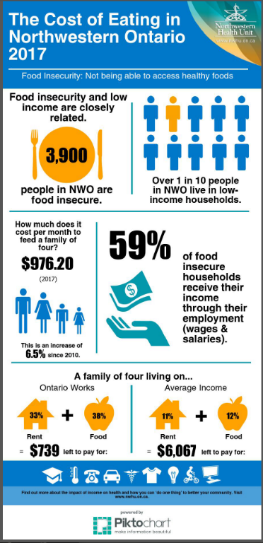
What is the NFB Survey?
Food costing tool
provides average food cost estimates for KRRDs/Province
List of 67 basic foods
examples include: cheese, yogurt, bread, milk, fruit, vegetables,
meats, peanut butter
Notes:
The Nutritious Food Basket (NFB) is a survey tool used to measure the cost of eating according to current nutrition recommendations and food consumption data. The NWHU conducts the survey annually using guidelines prepared by the Ministry of Health and Long-Term Care. The survey includes 67 food items, found in Canada’s Food Guide, that are used to prepare nutritious meals and snacks.
- examples include: cheese, yogurt, bread, milk, fruit, vegetables, meats, peanut butter, etc.
What items are not included?
The total cost does not include processed convenience foods, soft drinks, popular snack foods, special dietary foods, infant foods, religious or cultural foods, soap, shampoo, toilet paper or other personal items that people might add to their shopping cart. It also does not take into account eating out or inviting company to share a meal.
The assumption is that people have the time, skill, and equipment needed to cook low-cost staples. The survey does not include prepared convenience foods or household non-food items.
The survey is not done on reserve.
Taking a closer look at the 2017 the cost of feeding a family of four was $976.20 per month, an increase of 6.5% since 2010. For a family of four on Ontario Works in the NWHU area, 38% of their income is required for the purchase of food (NWHU, 2017).
Also, speak about Northern Food Basket Survey Report briefly. Sioux Lookout First Nations Health Authority. The study assessed food costs in three road-access First Nations Communnities in Northwestern Ontario – Wunnumin Lake, Sandy Lake and Sachigo Lake. The full report is available on our website.

Slide 14
First Nations vs. Non First Nations Communities (2015)
Notes:
Since 2016, the cost of feeding a family of 4 has increased in both First Nations* and non-First Nations communities. It costs 73% more to feed a family of 4 in a remote First Nations community*.
BUT…
In the FN communities that were sampled, many products and fresh foods that make up the nutritious food basket were unavailable in stores or were of such poor quality they could not be eaten. And so, it would only be possible for families to buy an ‘incomplete’ nutritious food basket that costs $1,421.36. The number $1,833.85 (used above) is a hypothetical cost that looks at what it would cost a family to buy the full nutritious food basket if the food items were good quality and actually available in the communities. So, what’s left over?
A family of four from a remote First Nations community* living on social assistance would receive a household income of $1,871.00.***
Purchasing an incomplete nutritious food basket would leave the family with $449.64 to cover expenses like household items (like toiletries, detergent and toilet paper), transportation, clothing, school supplies, children’s activities and emergency expenses.
Purchasing a full nutritious food basket would not be possible for this family. Doing so would put them $31.75 over budget. They would be forced to choose between healthy eating and covering the cost of expenses.
The bigger issue As the cost of living increases, incomes are not keeping pace. Since 2010, minimum wage has increased only 9.8%. Despite increases to social assistance, Ontarians earning minimum wage and those who receive social assistance do not earn enough money to ensure access to healthy food.
*The information shared above is based on a study completed by the Sioux Lookout First Nations Health Authority and Northwestern Health Unit. The study assessed food costs in three road-access First Nation communities in Northwestern Ontario – Wunnumin Lake, Sandy Lake and Sachigo Lake. The full report is available here: Northern Food Basket Survey Report – 2015.
* *Provided for reference. Source: NWHU Nutritious Food Basket Survey Results – 2015.
***Social assistance is based on Ontario Works: Basic Needs, Ontario Child Benefit, Max Shelter Allowance, Northern Living Allowance, Remote Communities Allowance

Slide 15
Why does the cost of FOOD matter?
People are forced to cut into their food budget to pay for other living expenses.
Heat/hydro
Transportation, car maintenance and gas
Child care
Phone
Clothing
Eye and dental care
School supplies
Notes:
We know that when money is tight, people are forced to cut into their food budget to pay for other living expenses. They skip meals, eat fewer vegetables and fruit, drink less milk, and fill up on non-nutritious foods because they are cheap. The result of this unhealthy diet is an increased risk of chronic illness, and poor growth and development in children.
Why can’t people afford healthy food?
For people living on minimum wage, Ontario Works, or the Ontario Disability Support Program, it’s hard to make ends meet. After paying rent, they still have to pay for other necessities such as:• Heat and hydro• Transportation, car maintenance and gas• Child care• Phone• Clothing• Eye and dental care• Home maintenance• Costs for children in school• Household cleaners and personal hygiene productsThis means that little money is left

Slide 16



①
⓪
⓪
①
③
②
Notes:
So what do we do with this information? Because of the relationship between food insecurity and poor health, PHUs engage in education and advocacy on our local NFB results. Activities include:
Reporting to Boards of Health with specific public policy recommendations that address the root causes of food insecurity, for example advocating to the provincial government for increased social assistance rates, increased minimum wages and more affordable housing.
Planning media and public education campaigns about the results of Nutritious Food Basket surveys using tools such as infographics, including the one from Ottawa Public Health shown on this slide.
Participating and collaborating with local basic income or poverty reduction groups to broaden advocacy efforts.
It is important to note that these are all examples of system-level upstream approaches.
About the slide:
Taking a closer look at the 2017 the cost of feeding a family of four was $976.20 per month, an increase of 6.5% since 2010. For a family of four on Ontario Works in the NWHU area, 38% of their income is required for the purchase of food (NWHU, 2017).
Also, speak about Northern Food Basket Survey Report briefly. Sioux Lookout First Nations Health Authority. The study assessed food costs in three road-access First Nations Communnities in Northwestern Ontario – Wunnumin Lake, Sandy Lake and Sachigo Lake. The full report is available on our website.
The NFB/food cost information is then combined with income and cost of rent, allowing us to assess whether different households are able to pay for these basic expenses, and how much money, if any, is left at the end of the month for other important expenses such as childcare, medication, transportation or clothing.
In this graphic, we can see that all but one household has money left after paying food and rent – typically, those living on their own and whose main income is OW do not have enough income to cover for these priority expenses. Food for thought question: what would this mean for you, if you were in this situation? What would you do to survive?
Not too far from this reality are the households with one adult supported by ODSP, as the money left after paying rent and food is little, leaving us wondering if it would be enough to pay for the other important costs already mentioned.
Overall this graphic confirms one of the aspects we discussed earlier – those relying on social assistance as their main source of income have higher risk of experiencing HFI.
2017 NFB family and income scenarios.
S1- 2 adults (male and female ages 31-50), 2 children (girl age 8, boy age 14); Ontario Works
S2- 2 adults (male and female ages 31-50), 2 children (girl age 8, boy age 14);
income is based on one minimum wage earner, 40hr/wk, $11.40/hr (minimum wage in May 2017)
S3- 1 adult (female age 31-50), 2 children (girl age 8, boy age 14); Ontario Works
S4- 1 adult (male age 31-50); Ontario Works.
S5- 1 adult (male age 31-50); Ontario Disability Support Program (ODSP)
S6- 1 adult (female age 70+); income based on Old Age Security and Guaranteed Income Supplement (OAS/GIS)

Slide 17
Key Considerations

Slide 18
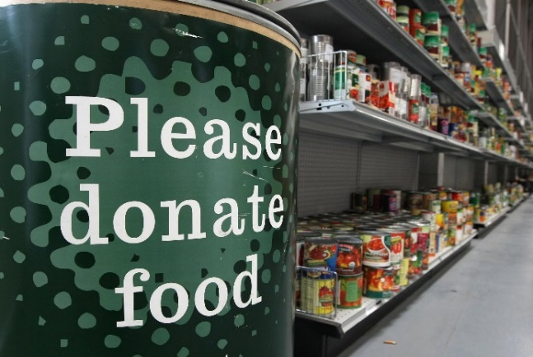
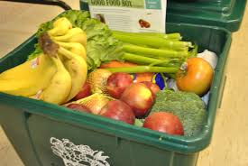
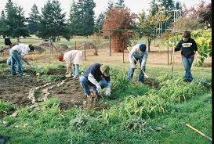
So-called “food security” programs
Food charity
Food banks
Community meals
Student Nutrition Programs
Coupons/vouchers
Community food programs
Community gardens
Collective kitchens
Good Food Boxes
Notes:
Responses to food insecurity have primarily been food-based; community organizations and public health units continue to call food charity and community food programs “food security programs”.
Food Charity
Food charity is not new and offering food to hungry people is considered the right thing to do in most cultures.
Food banks emerged in Canada in the 1980s in response to an economic downturn and proliferated during the 1990s and 2000s.
35 years later, food banks have become institutionalized and remain most wide-spread response to household food insecurity.
School-based feeding programs, although designed to be universal and enhance learning among all students, are typically considered a response for children who live in food insecure households.
Community Food Programs
Public health and other organizations have responded to limitations of this charitable approach through developing and supporting initiatives that focus on a more dignified approach. These include community gardens, collective kitchens, Good Food Box programs and workshops/programs that aim to help people “stretch their food dollars.”
While these programs may be effective for increasing participants’ food skills/food literacy, increasing access to nutritious food, and may offer social support and facilitate empowerment, there is no evidence they are effective at reducing household food insecurity.
Both community food programs and food charity represent “downstream” efforts in contrast to Nutritious Food Basket advocacy and education efforts which focus on root causes and are more “upstream″.

Slide 19
Food banks...solving hunger?
False impression that people receive enough from food banks
Defines ‘hunger’ as the problem and charity as the solution
Notes:
The image on the slide is from a national food drive campaign and gives the same message – that by “donating now″ we can “fill every empty plate″ so that “none of our neighbours will go hungry.″
With the growth and messaging that food banks “fill every empty plate”, the FSWG was increasingly concerned about:
The false impression that impoverished people receive enough food from food banks.
The portrayal of ‘hunger’ as the problem, and charity as the solution which creates low expectations of how citizens can act to end poverty.
The FSWG felt urgent action was needed to create common messages to use for advocacy and education on a provincial level and to give local public health unit staff consistent, evidence based messaging they can use in their local advocacy and education efforts.
What does the literature say:
So how do we know that these typical food bank campaigns are misconstruing and using ‘hunger’ to create the illusion that they offer a valid solution?
Why do we say that food banks are an ineffective response to food insecurity? Here’s what the literature says:
Less than 25% of those experiencing food insecurity use food banks
Accessing food banks can be challenging – where they are located, their hours of operation, long line ups and the administrative process to prove economic hardship
Food banks often do not reach the population that is the most severely food insecure
Stigmas and social exclusion are associated with food insecurity and food bank use
Food banks are inherently reliant on donors and volunteers – resources are limited
Food banks, the media, and public support of the charitable model which alleviates pressure on government to provide adequate income
As registered charities, food banks have limited advocacy opportunities
Food banks do not address the underlying root cause of food insecurity which is POVERTY
Food banks are not reducing food insecurity
Food banks were intended to be emergency relief in the face of a recession and have since been institutionalized – food banks are not a valid long-term solution

Slide 20
Food charity:
An ineffective response to food insecurity
Food insecurity requires a paradigm shift from an individual/household problem to a system problem that requires intervention with public policy
Social justice issue: the right to food
A counterproductive response to food insecurity
From a systems-level perspective, the existence of food banks creates the illusion that food insecurity is being taken care of in the community
Allows the government to neglect its obligation to ensure income security for all Canadians
Notes:
The position statement is premised on the evidence that poverty is the root cause of food insecurity and asserts that an income response is needed.
Food insecurity requires a shift in thinking from that of an individual/household problem to a system problem requiring public policy intervention
Food insecurity in Canada contravenes the country’s commitment to ensure the basic human right to food for all citizens, and therefore food insecurity is a social justice issue.
As outlined food charity is an ineffective response to food insecurity. But beyond the ineffectiveness, the existence of food banks is counterproductive to a movement towards addressing the root cause of food insecurity.
Food banks enjoy broad government, business, media and public support and OSNPPH rrecognizes that stating food charity is ‘counterproductive’ is a strong statement that challenges common beliefs about food banks and how they help people.
However, if we step back and assess the role of food banks from a systems level perspective, we see that the existence of food banks creates the illusion that food insecurity is being taken care of in the community.
With the existence of food banks, we become so conditioned to the need for raising more money and getting more food onto food bank shelves that we lose sight of the root cause of food insecurity which is poverty.
And while we are gathering food, the focus is taken off the government/country and its obligations to protect vulnerable and powerless people.
In Canada massive effort is needed for public education and advocacy to address the root causes of food insecurity and hunger, but researchers in this area argue that support for such efforts will be unlikely while food banks are such a well-established part of the fabric of many communities.
Governments have renounced previously held responsibilities for the well-being of citizens and they have left community-based charities to fill the gap. For example, government websites, case workers and health care providers routinely refer people to food banks. Photo ops of elected leaders at food banks endorse and normalize charity as a valid way to address food insecurity.
Increases in the charitable sector have coincided with the dismantling of social programs, such as tightened rules for Employment Insurance eligibility, reduced federal transfers for social housing, and the replacement of the Canada Assistance Plan with the Canada Social Transfer with no condition attached that provinces ensure adequacy of social assistance. It is argued by experts such as Elaine Power, Dennis Raphael and Graham Riches that this is no accident. It is a result of a deliberate shift in political ideology to have less government intervention and a shrinking social safety net. What we are left with is a situation where individuals are increasingly responsible for their own health and well-being. This has led to the acceptance and pervasiveness of charity and the ongoing prevalence of a severe public health problem, food insecurity.
.

Slide 21
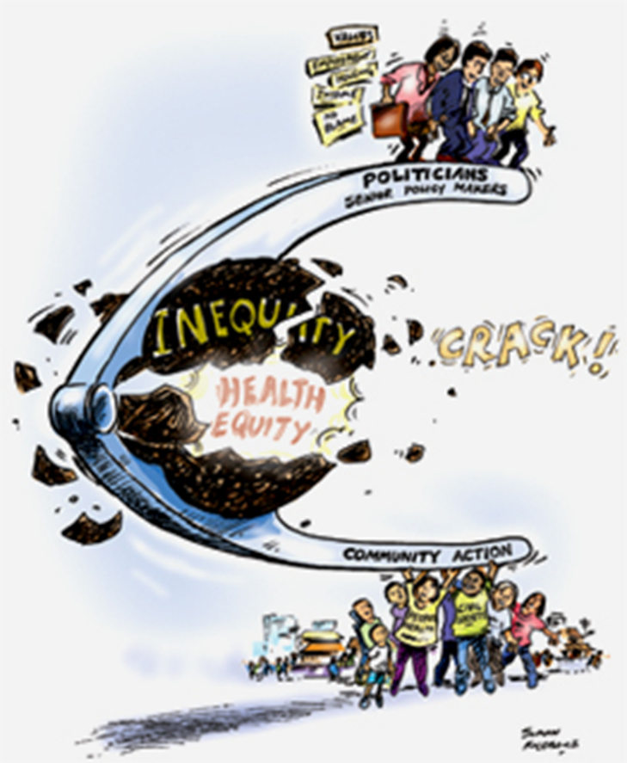
What is the solution?
Build social and political movement – “nutcracker effect”
Raise awareness, educate
Recognize barriers: political, social, economic
Adapted with permission from: “Placing the Social Determinants of Health on the Public Policy Agenda” presentation by Dennis Raphael and Toba Bryant at the Annual Meeting of the Canadian Public Health Association. Toronto, June 14, 2016.
Baum, F. (2007) Cracking the nut of health equity: Top down and bottom up pressure for action on the social determinants of health. Promotion & Education, 14(2), 90-95. See more at: http://nccdh.ca/resources/entry/cracking-the-nut-of-health-equity
Notes:
When we examine why no effective action is being taken on the social determinants of health, including food insecurity, we see that knowledge dissemination on the social determinants of health is limited to researchers, public health professionals and policymakers rather than citizens. This allows for Canadian governments’ minimizing their intervention in the market economy. When governments aren’t under pressure to act, they don’t, and charity steps into the void.
These barriers point to key actions for public health staff to address.
This “nutcracker” image is from Fran Baum from Australia. The nutcracker image offers a theory for effective action on the social determinants of health, including food insecurity. That is, both top-down political commitment and bottom-up action from civil society groups are needed.
This points to the need to raise awareness about problems related to health inequity. In doing so, we as public health professionals need to recognize political, social and economic barriers. One example is the barrier of concerns that a guaranteed income will cost too much. This is where our knowledge of and commitment to the cost effectiveness of prevention and addressing the social determinants of health come in.

Slide 22
What public health can do
Build social and political movement to address SDOH
Raise awareness, educate about BIG, living wage
Notes:
Public health interventions have to move upstream to address SDOH like poverty
Support programs like basic income pilot

Slide 23
What can we/you do?
Learn more about food security, poverty and Basic Income Guarantee/Guaranteed Annual Income.
• Speak out. As a citizen you can help increase awareness about the need for long-term solutions to food insecurity and poverty by sharing information with friends, family, neighbors and co-workers.
Use your skills. Become part of a local committee or group focused on reducing poverty and food insecurity, or write a letter to your local Member of Parliament.
Notes:
If you are part of a service organization, such as a food bank, you can advocate for long term solutions that will reduce dependency on emergency sources of food.

Slide 24
What can we/you do?
Avoid perpetuating the message that charity or community food programs are effective responses to food insecurity.
Focus on ‘upstream’ or systems efforts when possible.
Check out the Cent$less campaign
This campaign aims to raise awareness of the need for income solutions for food insecurity
No Money for Food is…Cent$less
Notes:
Regarding applications of this Position Statement to public health, there are two key points to highlight:
Avoid perpetuating the message that charity or community food programs are effective at reducing food insecurity. These programs can have their benefits, but addressing food insecurity is not one of them, and many people experiencing food insecurity do not participate in these programs.
And finally, we urge the focus to be on upstream or systems efforts whenever possible.
Send from personal email address

Slide 25
For More Information
NWHU Cost of Eating in NWO Infographic
NWHU Community Food Programs directory
ODPH Position Statement on Responses to Food Insecurity
ODPH Food Insecurity Infographic
http://decentworkandhealth.org/

Slide 26
Thank you for your time!
If you have any questions call Julie (310713) or Chelsea (301243)
Notes:
Thank you very much for your time.
Are there any questions?

